Slide 1
Center for Risk and Economic Analysis of Terrorism Events (CREATE)
DHS Centers of Excellence Summit Showcase
May 19, 2021

Slide 2

CREATE: The National Center for
Risk and Economic Analysis of Terrorism Events
First Center of Excellence funded by DHS
  Competition of 72 universities in 2003
  Focused on risk and economic analysis
  Co-Founders Randy Hall & Detlof von Winterfeldt
Research Areas
  Risk Analysis
  Economic Analysis
Objective
  To improve homeland
  security decisions and
  operations

Slide 3
Research and Analysis Framework
Risk Analysis
Behavioral Analysis
Decision Analysis
Economic Analysis

Slide 4
CREATE Mission Statement
CREATE's Mission is to improve our Nation's security through research and development of advanced models and tools to evaluate risks, costs, and consequences of terrorism and natural man-made hazards, and to guide economically viable investments in homeland security. We are accomplishing our mission through an integrated program of research, education and outreach that is designed to inform and support decisions faced by public and private sector decision-makers at the national, state, and local levels. We are also working to leverage the investments being made by the Department of Homeland Security and to facilitate the transition of research toward practical tools to improve security.

Slide 5
CREATE Professional Stature
Leading Center for research on risk analysis, decision analysis, behavioral analysis, economic consequence analysis, and resilience
  multitude of honors and awards
  quality and quantity of publications
  valuable transitioned products
“Go to” place for expertise in these areas by researchers and government agencies
16 External Fellows – Leaders in their fields
Providing expertise through funding to other COEs: CIRI, CAOE, BTI, CCICADA, CBTS
Impact on decision-making (CBP, U.S. Coast Guard, FEMA, Congress, state & local governments)
Mentoring and placement of grad students and post-docs (Ohio State, UCI, Texas Tech, CSUDH, RAND, LA Mayor’s Office, PNNL, NERA, Facebook)

Slide 6

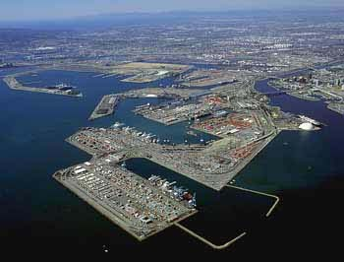



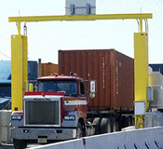
Some Early Projects
Dirty Bomb Attacks on Harbors
Randomized Searches & Patrols
MANPADS Countermeasures
Infrastructure Protection
Advanced Radiation Detection
More Security Games

Slide 7
Modeling Adversary Decisions
Terrorism Threat Assessment
Adversary Motivations and Objectives
  Conflicting Objectives; Trade-offs
Adversary Response to Countermeasures
  Cognitive Biases and Heuristics
  Misperception of Uncertainty
Allocation of Resources
  Threat Reduction (Deterrence)
  Vulnerability Reduction (Interdiction)
  Consequence Mitigation

Slide 8
Public Risk Perception
Public Response to Extreme Events
  Impact on Costs
Affect
  Fear v. Anger
Risk Perception
  Psychological Distance
Avoidance Behavior
Public Perceptions of Countermeasures
  Efficacy
  Inconvenience

Slide 9
Public Response to Extreme Events
Terrorism
  Anthrax attack on a major urban city
  MANPADS attack on commercial planes
  “Soft target” attacks on public transportation
  Repeated sustained attacks on “soft target” infrastructure
Natural Disasters
  COVID-19
  Large Earthquake
  Severe Tornados
  Hurricanes
  Floods
Cyber Attacks
  Virus Attacks
  Phishing Attacks
  Identity Theft
  Nuclear Power Plant

Slide 10
CREATE Economic Consequence Analysis Framework
Disaster
Event Scenario
Loss of Life
Direct Economic Impacts
Direct
Remediation
Costs
Resilience
Adjustments
Mitigation
Costs
Behavioral
Linkages
Ordinary Indirect
Economic Impacts
Spillover
Effects
Total Economic
Impacts

Slide 11
COVID-19 Causal Factors
Mandatory closures [Behavioral Linkage in part]
Reopenings [Behavioral Linkage in part]
Resilience through telework [Resilience]
Workforce declines due to health issues
Consumption & workforce declines due to avoidance [Behavioral Linkage]
Changes in net demand for health care services [Behavioral Linkage in part]
Increases in net demand for communication services [Resilience]
Pent-up demand [Resilience]

Slide 12

CREATE Projects and Research
Impacts of the Coronavirus
on the U.S. Economy
For more than a decade, researchers at CREATE have worked on analyzing various aspects of health threats, such as their severity and timing, costs to healthcare, availability of vaccines, avoidance behavior, resilience and economic consequences. CREATE continues to build upon past research to assess and advise on the economic impacts and risk management of COVID-19.
For more information, visit:
https://create.usc.edu/coronavirus-updates-research-and-media-mentions/

Slide 13
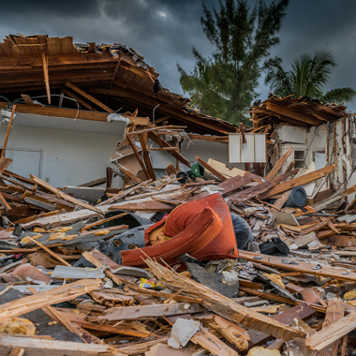
CREATE Projects and Research
Using Gain-Loss Framing to Nudge Homeowner Mitigation and Insurance Purchase for Natural Disasters
Homeowner risk mitigation and insurance purchase decisions were reframed by moving the usual status quo reference point to compare gain and loss frames. Results indicate that a gain-frame is more likely to lead to risk-averse homeowner decisions to mitigate for floods and hurricanes, but not for earthquakes. Disaster-specific framing effects provide unique implications enhancing resilience.
For more information, visit:
https://create.usc.edu/create-researchers-study-gain-loss-framing-to-nudge-homeowner-mitigation-and-insurance-purchase-for-natural-disasters/

Slide 14

CREATE Projects and Research
Researchers Study Motivations of Northern Triangle Migrants
CREATE study shows that asylum-seeking migrants from the Northern Triangle countries of El Salvador, Guatemala, and Honduras are primarily motivated by economic opportunities to come to the United States, and that they are unlikely to divert to migrating to Mexico if U.S. asylum policies are changed.
For more information, visit:
https://create.usc.edu/create-researchers-study-motivations-of-northern-triangle-migrants/

Slide 15
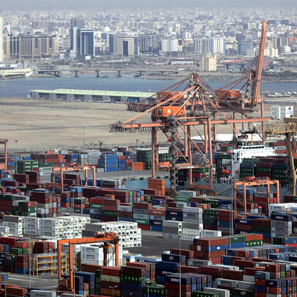
CREATE Projects and Research
Research on Transportation Logistics
in Post-Conflict Zones
CREATE received a $972,000 grant for a study on “Economic Viability, Resilience, and Sustainability of Logistic Systems in Post-Conflict Zones” from the Minerva Program, the premier Department of Defense source of basic social and behavioral science research.
For more information, visit:
https://create.usc.edu/prestigious-department-of-defense-grant-awarded-to-usc-create-to-study-transportation-logistics-in-post-conflict-zones/

Slide 16
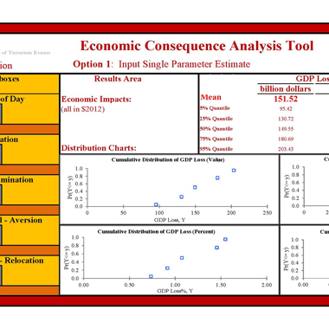
CREATE Projects and Research
Economic Consequence
Analysis Tool (E-CAT)
CREATE’s Economic Consequence Analysis Tool
(E-CAT) is intended for policymakers and analysts who need quick estimates of the economic impact of threats listed in the Homeland Security National Risk Characterization (HSNRC) Register. It provides estimates of the impact of terrorist attacks, natural disasters, and technological accidents on U.S. GDP and employment, and is programmed in Excel Visual Basic to facilitate its use.
For more information, visit:
https://create.usc.edu/e-cat-software-now-available/

Slide 17

CREATE Projects and Research
Cybersecurity
CREATE’s research on cybersecurity includes: the role of judgment biases and heuristics in cybersecurity risk perception and decision-making; the psychology of cyber deterrence using behavioral games; and the creation of models employing game theory, computable general equilibrium (CGE), and benefit-cost analysis (BCA). A cyber-attack module was also developed for use within the Economic Consequence Analysis Tool (E-CAT).
For more information, visit:
https://create.usc.edu/create-research-on-cybersecurity/

Slide 18

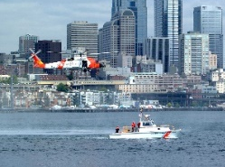
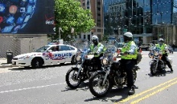

R&D Results Transition Framework
End-to-End Research and Technology Transition has been an integral component of CREATE’s R&D framework
Highlighted by R&D performer immersion in operational setting
Risk-Based Policy- and Decision-Making Impact
Risk and Decision Analysis
Immersion
End-to-End Research Transition
Risk Management / Operations Research
Risk Perception and Communication
Economics Analysis
Risk-Based Resource Allocation Impact

Slide 19








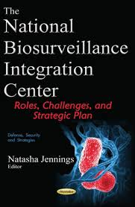

Practical Operational Domain Partners
CBP
CISA
DNDO
FAMS
ICE
NBIC
TSA
USCG
Cal OES / CalEMA / CA OHS / CEC
JRIC
LA County Sheriffs Dept.
LAX International Airports
Ports of LA & LB
Ohio Highway Patrol

Slide 20
Transitioned CREATE Projects
ARMOR – Game Theory-based resource allocation
CBP Wait-Time Study – Economic study of value of CBP OFO officers at US borders
DET – Dirichlet expert elicitation and aggregation tool for risk
analysis
E-CAT – Economic Consequence Analysis Tool
EQ Rapid Estimation – Economic consequence estimating tool
MANPADS – Risk analysis of surface-to-air missile attacks
PortSec – Port (POLA/LB) risk assessment and resource
allocation analysis tool
Risk Communication – How to deliver risk messages for impact

Slide 21
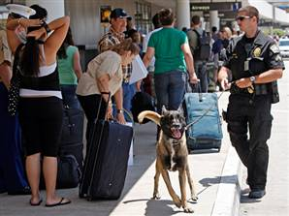

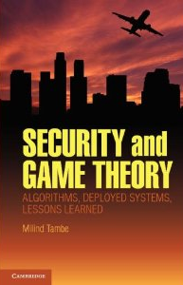


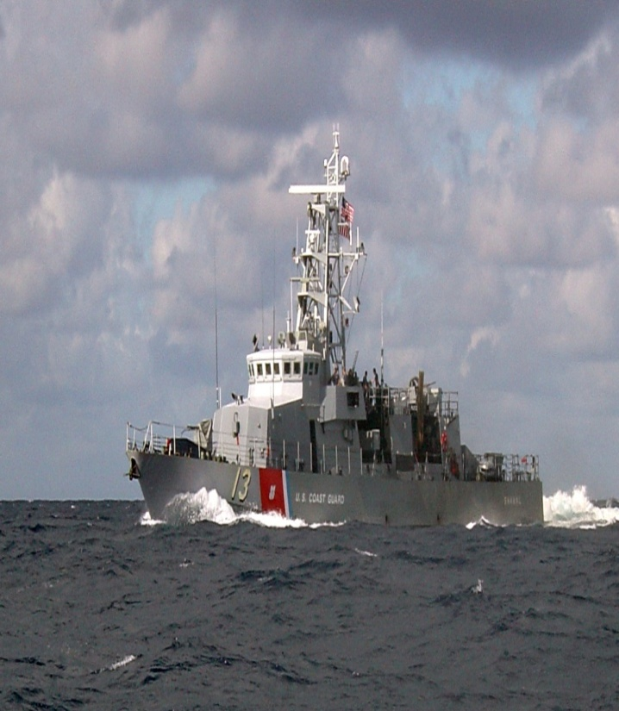


ARMOR: Game Theory Applications
ARMOR - LAX
ARMOR – IRIS: FAMS
ARMOR – PROTECT: USCG
ARMOR – GUARDS: TSA

