Slide 1
Economic Consequence
Analysis Tool: E-CAT
Adam Rose (USC)
Zhenhua Chen (OSU)
Fynn Prager (CSDH)
Sam Chatterjee (PNNL)
May 19, 2021

Slide 2
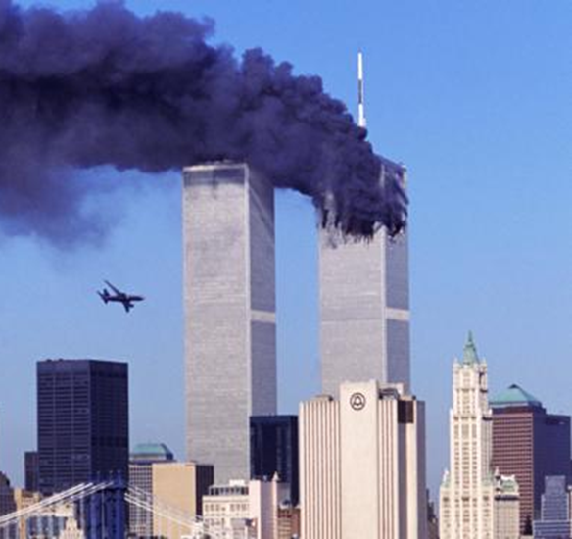
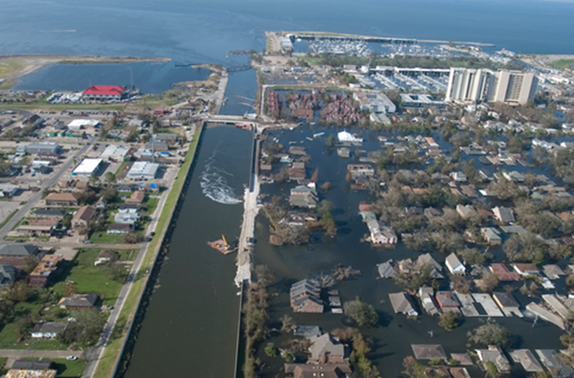



Slide 3
HSNRC Risk Register
Terrorism / Intentional Acts
Aircraft as a Weapon Armed Assault Biological Terrorism Attack - Non-Food Chemical / Biological Food Contamination Terrorism Attack Chemical Terrorism Attack - Non-Food Cyber Events that Impede System Operations Cyber Events that Extract or Alter Information without System Impacts Cyber: Data Destruction Results in Degraded Commercial Viability or Government Service Cyber: Distributed Denial of Service (DDOS) Attack Causes Erosion of Consumer Confidence and Economic Loss Disruptive Strike / Industrial Action Explosives Terrorism Attack Illegal Immigration Illicit Drugs Mass Migration Nuclear Terrorism Attack Radiological Terrorism Attack
Natural Hazards
Accidental Biological Food Contamination Animal Disease Outbreak Drought Earthquake Extreme Cold / Snowstorm Flood Heat / Heat Wave Human Pandemic Outbreak Hurricane Space Weather Tornado Tsunami Volcano Eruption Wildfire
Technological Accidents / Infrastructure Failures
Accidental Chemical Substance Spill or Release Accidental Radiological Substance Release Dam Failure Industrial Accidents - Explosions Large Oil Spills Pipeline Failure Power Grid Failure Small Oil Spills Transportation System Failure Urban Conflagration

Slide 4
Economic Consequences of Bioterrorism Attacks
(gross output impacts in billions of 2007 dollars)

Slide 5
Objectives
  Develop a standardized capability to estimate economic consequences of 30+ types of threats
- includes a comprehensive set of impact categories
- standardization facilitates comparisons
  Transition the research into a user-friendly, fast software tool for high-level decision-makers
- risk mgt: resource allocation across multiple threats
- rapid response: estimates for remediation/aid/recovery

Slide 6
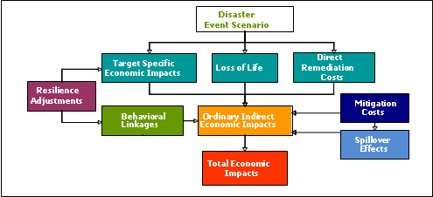
CREATE Economic Consequence Analysis Framework

Slide 7
Economic Resilience
Static:
- General Definition: Ability of a system to maintain
function when shocked.
- Econ Definition: Efficient use of remaining resources
at a given point in time to produce as much as possible.
Dynamic
- General: Ability & speed of a system to recover.
- Economic: Efficient use of resources over time for
investment in repair and reconstruction, including
expediting the process & adapting to change
Metric: averted losses as % of potential losses

Slide 8
Measuring Econ Resilience of 9/11
95% of over 1,100 WTC area firms relocated after 9/11
If all of firms in the WTC area went out of business, direct business interruption (BI) loss would = $58.4B
If all relocation were immediate, then BI = $0
Businesses relocated 2 to 4 months, BI = $16.1B
Resilience Metric: Avoided Loss ÷ Max Potential Loss
$42.3B ÷ $58.4B = 72%

Slide 9
Cyber Resilience Options
Category |  | Action/Investment |  | Cost of Resilience |  | Effect of Resilience
Conservation
• reduce non-essential use |  | data consolidation |  | more than pays for itself |  | significant
• remove non-essential access |  | remove non-essential administrator access |  | more than pays for itself |  | significant
Input Substitution
• paper records, couriers |  | re-contract |  | low to moderate cost |  | significant at small scale
• flexibility of input combos |  | supply procurement |  | low |  | significant
• wireless-to-wired, wired-to wireless internet/phone access |  | use text messaging or social media |  | low to moderate cost |  | significant
 |  | satellite phones |  | low to moderate ($189-$300 monthly rental charges; $6-$9 per minute) |  | moderate to large (most reliable method of communication)
 |  | cellular signal boosters |  | low (small scale: ~$850; large business: ~$3,500; industrial scale: ~$4,000) |  | moderate to large (restores cell coverage; improved battery life for devices)
• supply-chain management |  | multi-sourcing strategy |  | loss of quantity discount; higher admin costs; reduces strength of partnerships; competition leads to lower costs |  | moderate

Slide 10
Behavioral Linkages
Off-site responses associated with behavioral changes (business, household, investor, worker)
Emanates from social amplification of risk & stigma effects (media coverage, rumor)
Fear feeds on itself and spreads
Translates into direct and indirect BI losses
Can be 2 to 3 orders of magnitude higher

Slide 11
Behavioral Linkage Examples
9/11 led to a 2-year reduction in air travel
Workers fear of riding the subway/bus
Business fear of staying open after dark
Investor fear of taking high risk
General avoidance behavior
Gov’t premature shutdown or evacuation

Slide 12
E-CAT Analytical Stages
Step 1:
Enumeration Tables
Step 2:
Direct Impact
Step 3:
User Interface Variables
Step 4:
CGE Analysis
Step 5:
Reduced Form Analysis
Step 6: Uncertainty Analysis
Step 7:
E-CAT Tool
Enumeration Tables – Qualitative Direct Impact estimates identified from historical data, literature, or expert judgment
Lower- and upper-bound Direct Impact values estimated for each category above the “Low Influence” threshold
User Interface Variables identified:
  (Magnitude, Time of Day, Duration, Economic Structure, Location, Clean Up,
  Behavioral Avoidance & Aversion, Resilience Relocation, Substitution, Recapture)
Randomized draws of 100 variable combinations converted to CGE inputs and run to estimate GDP and employment impacts
Reduced-form equation estimated with OLS & quantile regression
Uncertainty distributions generated with reduced-form results
Reduced-form equations and uncertainty analysis combined into the user-friendly interface of the E-CAT tool

Slide 13
Steps 1, 2, 3: Categories of Economic Impacts
Direct Impact Category | Lower Bound: Colorado Flood (September 2013; 2,400 sq. miles) |  |  |  | Upper Bound: Midwest Flood (March 1993; 30,000 sq. miles)
2. Evacuation and/or Quarantine |  | +/- $5M | Household spending | 0.0% |  | +/- $314M | Household spending | 0.02%
3. Clean-up / Decontamination |  | +/- 40,000 gal. of oil | Waste services productivity | 0.1% |  | +/- $3B | Waste services productivity | 3.6%
 |  |  | House-hold tax | 0.1% |  |  | House-hold tax | 2.5%
5. Mortality/Morbidity (humans)
a. Deaths |  | 10 | Labor factor usage | -0.0% |  | 52 | Labor factor usage | -0.0%
9. Infrastructure Interruption/ Aversion | M/L | -$547M |  |  | M | -$4B⁶
a. Transportation | M/L | -$422M | Capital stock | -0.9% | M | -$2B⁸ | Capital stock | -4.5%
 |  | -$105M | Productivity factor | -0.03% |  | -$507M | Productivity factor | -0.2%
b. Water | L | -$4M | Side calculation | Outage of 1 day equivalent -$2B (0.01%) | L | -$29M | Side calcu-lation | Outage of 4 weeks equivalent -$60B (0.4%)
c. Natural Gas | L | 4,800 building outages |  |  | L
d. Electricity | L | 1015 building outages |  |  | L
e. Education | L | 685,504 students (16 days) |  |  | L
f. Agriculture | L | -$5M | Productivity factor(agro) | -0.0% | M/H | -$12B | Productivity factor(agro) | -4.3%
17. Property Damage | M/L | -$86M | Capital stock | -0.01% | M/H | -$4B | Capital stock | -0.5%
Notes:
Enumeration Tables and Direct Impact are constructed with an extensive review of the literature:
Articles which do these analyses for a single threat (we sought information with respect to CGE modeling approaches, direct impact input parameter values, and used these for external validation checks)
Reports (news, government, think tanks) on threats – to gauge the scale of events, direct impact values
Databases of events
Department of Homeland Security National Planning Scenarios
To make this process manageable, we narrow the number direct impact “shocks” to the CGE model by removing all direct impacts classified as “Low” and hence result in impacts less than $100M, fewer than 100 deaths, and fewer than 1,000 illnesses or injuries.

Slide 14
Step 4: USCGE Model Overview
A model of the entire economy based on decisions by individual producers & consumers in response to price signals, regulations & external shocks, within limits of available capital, labor & natural resources.
Model Details
- 58 Economic Sectors
- 3 Factor Payment types (Labor, Capital, Proprietors
Income) plus Value-Added & Taxes
- 9 Household Income Brackets
- Other Institutions, including Trade

Slide 15
Step 4. CGE Modeling Base: Direct Impacts
Direct Impact Category | Model Variables and Simulation Approach
1. Vaccination | Increased household spending on Health
2. Quarantine and/or Evacuation | Increased household spending on Transport
3. Decontamination | Stimulus to Waste Management sector; Increases in government tax on households to pay for decontamination
4. Medical Expenditures | Increased household spending on Health
5. Mortality/Morbidity (humans)
a. Deaths | Permanent reduction in total labor force
b. Infected/Injuries | Temporary reduction in total labor force
c. Other (Caregivers) | Temporary reduction in total labor force
6. Risk Management
a. Information Gathering | n.a.
b. Administration | n.a.
7. Behavioral Effects: Aversion
a. Internat’l Travel— foreign visitors | Reduction in exports for goods foreign visitors purchase in the U.S.
b. Internat’l Travel— residents abroad | Reduction in household spending on foreign air travel; Increased budget available to households for spending on domestic travel or other goods and services
c. Domestic Tourism | Reduction in household spending on domestic tourist activities
d. Public Gatherings/Places | Reduction in household spending on domestic entertainment activities
8. Behavioral Effects: Other
a. Public Anxiety | n.a.
b. Wage Premiums | Increased wage rate to entice individuals to work in areas perceived as risky after a disaster
c. Rate of Return Premiums | Increased capital rate of return to entice individuals and corporations to invest in areas perceived as risky after a disaster
d. Other (customer discounts) | Reduction in prices to entice individuals to purchase goods and services from businesses in areas perceived as risky after a disaster

Slide 16
Estimation of Reduced-Form Model
Establishes the linkages between the CGE “driver” inputs and the user E-CAT software interface equations
Five steps:
  Latin-hypercube random sampling procedure
  CGE simulation with automatic loop function
  Data validation and testing
  Ordinary least square estimation
  Quantile regression

Slide 17
Loop Function Mechanism for CGE Computations

Slide 18
Maritime Cyber Research Highlights
For the first time, economic consequences of maritime cyber threats are evaluated using an advanced modeling framework
The framework captures the interactions of economic activities in a supply-chain system and various resilience tactics
A Reduced-form approach is developed tor provide rapid estimates for decision-making
Results provide policy implications for risk management of maritime cyber threats

Slide 19
Regression Results: Cyber Scenario

Slide 20
Sources and Types of Uncertainty
Event Characteristics
  Variability in magnitude, timing, duration, location, etc.
Economic Structures
  Differ across regions directly impacted
Uncertainty Characterizations
  Mathematical intervals
  Statistical probability distributions
  Intervals of probability distributions

Slide 21
Uncertainty Quantification and Propagation Tasks
Monte Carlo (MC) Sampling with Variance Reduction
  Latin Hypercube method for evenly distributed samples
  Generate synthetic data for E-CAT user interface input variables
Ordinary Least Squares Regression (OLS) Analysis
  Characterize uncertainty of regressors (explanatory variables) in least squares regression models
  Propagate uncertainty in regressors to consequences using MC simulation
  Develop probability distributions of consequences from MC simulation outputs
Quantile Regression (QR) Analysis
  Estimate conditional quantiles of consequences (e.g. 5%, 25%, 50%, 75%, and 95%) using MC simulation
  Develop probability distributions of consequences with quantiles

Slide 22
Uncertainty Representation: Point
Option 1 (User Inputs as Point Estimates)
  Probability Mass Functions
  Box and Whisker Plots
75%
95%
50%
25%
5%

Slide 23
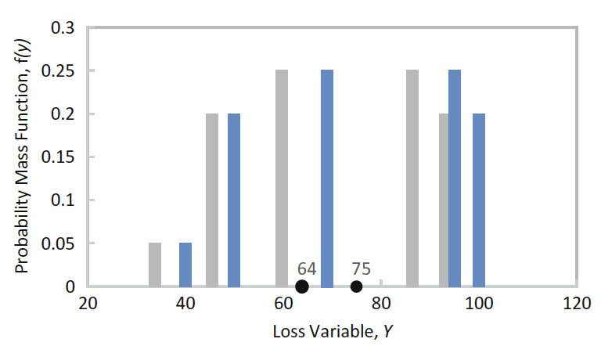
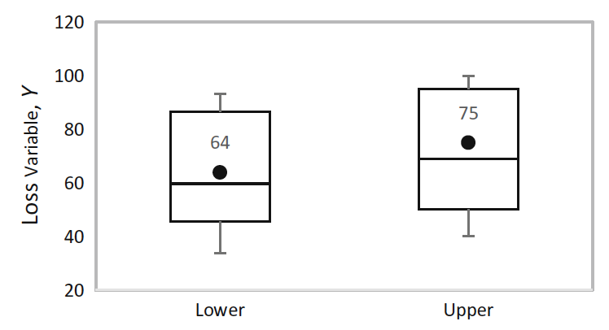
Uncertainty Representation: Interval
Option 2 (User Inputs as Mathematical Intervals)
  Probability Mass Functions with Bounds
  Box and Whisker Plots with Bounds
Probability Mass Function, f(x)
Consequence variable, x
75%
95%
Consequence variable, x
50%
25%

Slide 24
Uncertainty Rep: Entire Distribution
Option 3 (User Inputs as Triangular Probability Distributions)
  Empirical Cumulative Distribution Functions for mean and quantiles
  Relative Frequency Distribution

Slide 25
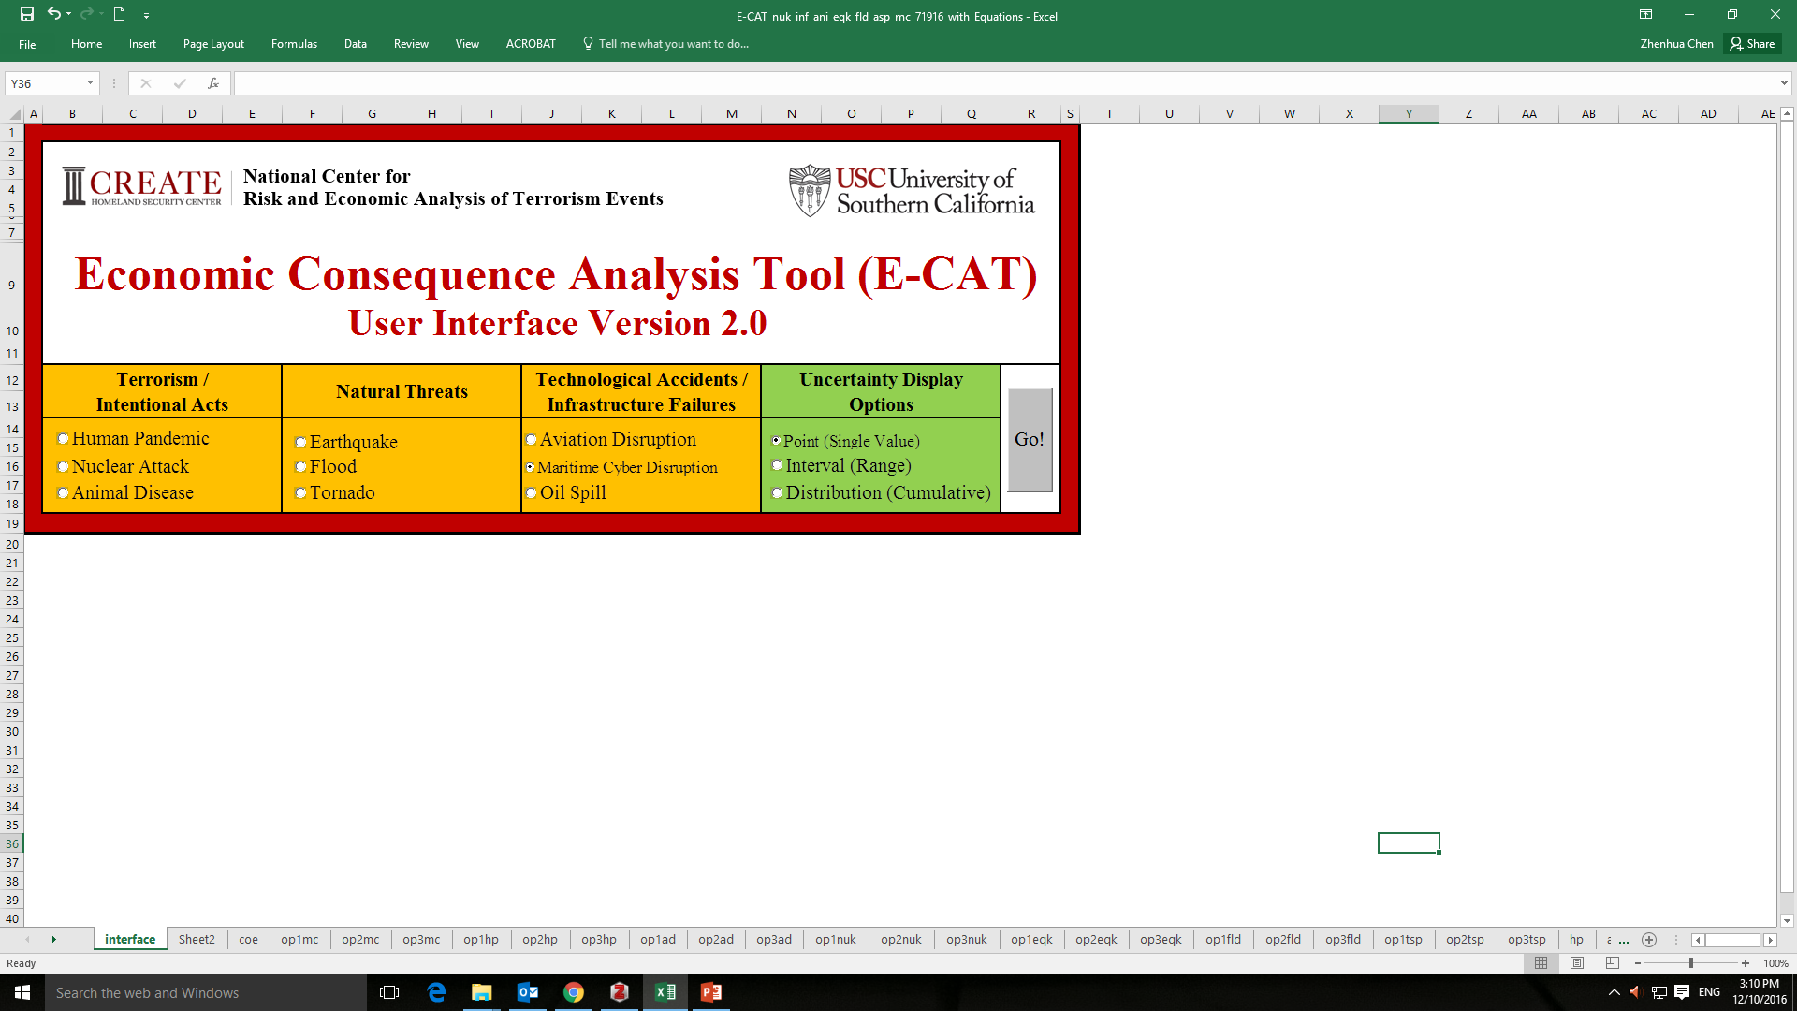
E-CAT User Interface

Slide 26
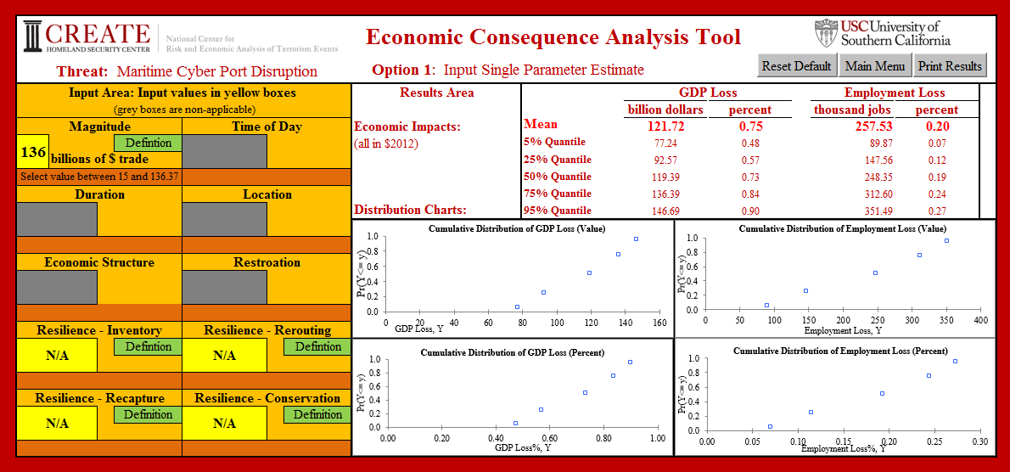
Point Estimate: Default Value

Slide 27
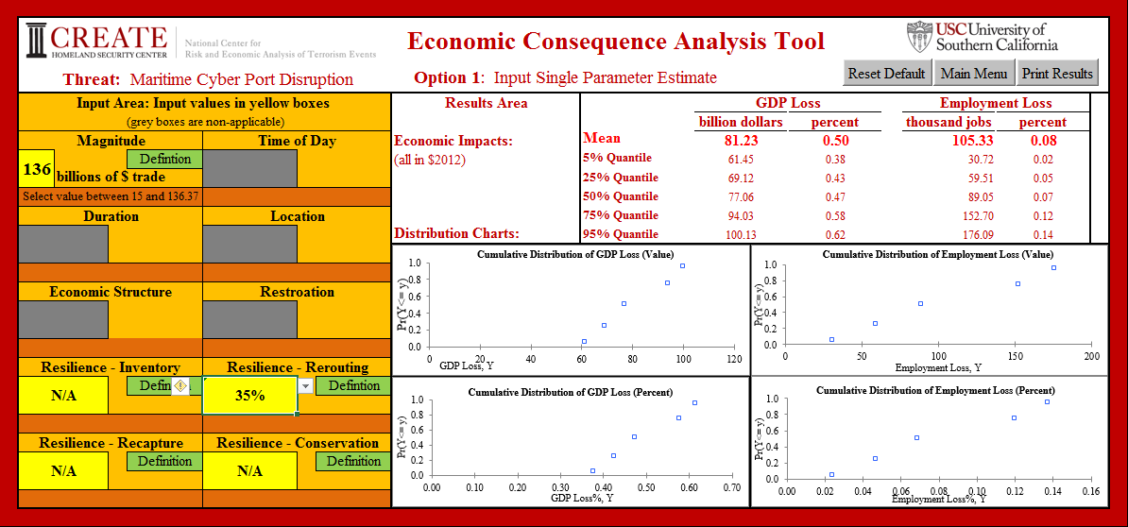
Adjust Ship-Rerouting Resilience =35%

Slide 28
E-CAT Summary
Comprehensive and standardized estimates of economic consequences for 30+ HSNRC threats
Solid foundation
- based on 10 years of research on ECA
- use of computable general equilibrium analysis
- vetted in case studies & peer reviewed literature
Incorporates major types of uncertainty
User friendly
- reduced-form format (single equation, major drivers)
- programmed in Excel VBA (Visual Basic Applications)

Slide 29
Economic Consequence Publications
Rose, A., F. Prager, Z. Chen and S. Chatterjee. 2017. Economic Consequences Analysis Tool (E-CAT). Singapore: Springer.
Chen, Z., A. Rose, F. Prager and S. Chatterjee. 2017. “Economic Consequences of Aviation System Disruptions: A Reduced-Form Computable General Equilibrium Analysis,” Transportation Research A 95 (January): 207–226.
Rose, I. Sue Wing, D. Wei and A. Wein. 2016. “Economic Impacts of a California Tsunami,” Natural Hazards Review, 17(2).
Prager F., D. Wei, and Rose. 2016. Total Economic Consequences of an Influenza Outbreak in the United States,” Risk Analysis, published on-line thus far.
Rose, A. 2015. “Macroeconomic Consequences of Terrorist Attacks: Estimation for the Analysis of Policies and Rules," in C. Mansfield and V.K. Smith (eds.), Benefit Transfer for the Analysis of DHS Policies and Rules, Cheltenham, UK: Edward Elgar.
Rose, A. and E. Krausmann. 2013. “An Economic Framework for the Development of a Resilience Index for Business Recovery,” International Journal of Disaster Risk Reduction 5(October): 73-83
Rose, A. and D. Wei. 2013. “Estimating the Economic Consequences of a Port Shutdown: The Special Role of Resilience,” Economic Systems Research 25(2): 212-32.
Geisecke, J., A. Rose, P. Slovic et al. 2012. "Assessment of the Regional Economic Impacts of Catastrophic Events: A CGE Analysis of Resource Loss and Behavioral Effects of a Radiological Dispersion Device Attack Scenario," Risk Analysis 32: 583-600.
Whitehead, J., and A. Rose. 2009. "Estimating Environmental Benefits of Natural Hazard Mitigation: Results from a Benefit-Cost Analysis of FEMA Mitigation Grants," Mitigation & Adaptation Strategies for Global Change 14: 655-76.
Rose, A. 2009. The Economics of Climate Change Policy, Cheltenham, UK, Edward Elgar Publishing Company.
Rose, A., G. Oladosu, B. Lee and G. Beeler Asay. 2009. "The Economic Impacts of the 2001 Terrorist Attacks on the World Trade Center: A Computable General Equilibrium Analysis," Peace Economics, Peace Science, and Public Policy 15: Article 6.
Rose, A., G. Oladosu, and S. Liao. 2007. “Business Interruption Impacts of a Terrorist Attack on the Electric Power System of Los Angeles: Customer Resilience to a Total Blackout,” Risk Analysis 27:13-31.

