Slide 1

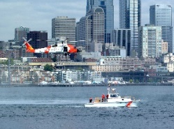
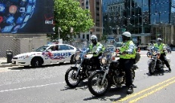

R&D Results Transition Framework
End-to-End Research and Technology Transition has been an integral component of CREATE’s R&D framework
Highlighted by R&D performer immersion in operational setting
Risk-Based Policy- and Decision-Making Impact
Risk and Decision Analysis
Immersion
End-to-End Research Transition
Risk Management / Operations Research
Risk Perception and Communication
Economics Analysis
Risk-Based Resource Allocation Impact

Slide 2
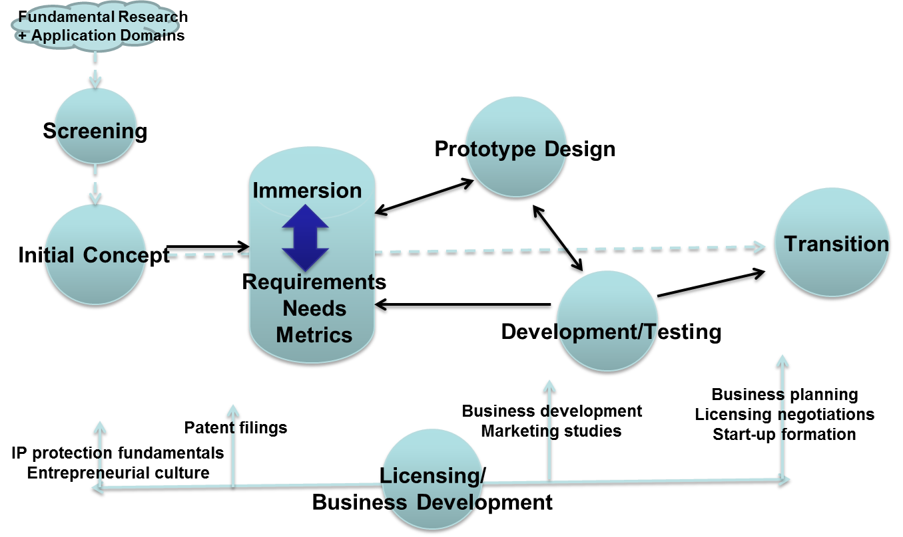
CREATE’s Research Transition Pathway

Slide 3








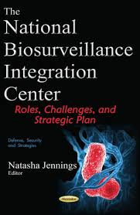

Practical Operational Domain Partners
CBP
CISA
DNDO
FAMS
ICE
NBIC
TSA
USCG
Cal OES / CalEMA / CA OHS / CEC
JRIC
LA County Sheriffs Dept.
LAX International Airports
Ports of LA & LB
Ohio Highway Patrol

Slide 4
Transitioned CREATE Projects
ARMOR – Game Theory-based resource allocation
CBP Wait-Time Study – Economics study of value of CBP OFO officers at US borders
DET – Dirichlet expert elicitation and aggregation tool for risk
analysis
E-CAT – Economic consequence analysis tool
EQ Rapid Estimation – Economic consequence estimating tool
MANPADS – Risk analysis of surface-to-air missile attacks
PortSec – Port (POLA/LB) risk assessment and resource
allocation analysis tool
Risk Communication – how to deliver risk messages for impact
Notes:
Chronologically, value from right from CREATE’s founding, starting with MANPADS study
CBP Wait-Time Study: Monetary Value of Reduced Wait Time by Passengers at border crossing Primary Inspection Queues
Risk Communication Experiment: Economic Impact of Attacks on Commercial Airline -- Public reaction following attack: ~6-9% reduction in air travel first year
Estimated revenue loss to airlines: $8.9 billion
Estimated loss to US GDP: $13.1 billion
Risk Message: May reduce lost airline revenues >$400 million, and a “Risk Message” can be effective in protecting confidence in DHS to handle national crisis following an attack

Slide 5
Research Transition/Application Impact
“CREATE has provided several very timely, relevant deliverables to the Counter-MANPADS Systems Program Office ... . As the program has progressed, there has been a growing need to show the benefits relative to the costs of outfitting the commercial aircraft fleet with such technologies … . The CREATE products, which include an economic analysis of the indirect costs associated with a successful MANPADS attack, have helped fill this void.” (Counter-MANPADS Program Office, email message from Kurt Wohlstaetter to Detlof von Winterfeldt)
Director of the MANPADS Systems Program Office
“We have tested IRIS and…have continued to expand the number of flights scheduled using IRIS. Our exact use of IRIS is sensitive information and we can only state that we are satisfied with IRIS and confident in using this scheduling approach.”
James B. Curren, Special Assistant, Office of Flight Operations
Federal Air Marshals Service (FAMS)

Slide 6
Value of Transitioning Products: CREATE’s Landscape Project – Costs, Medians, Ranges of Net Present Values
Notes:
Median Benefit-Cost Ratio = $415,193/$15,363 = 27
Landscape study journal paper reference …

Slide 7
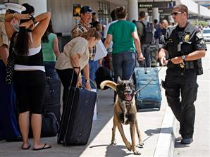

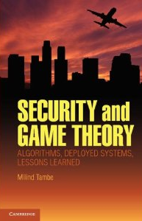

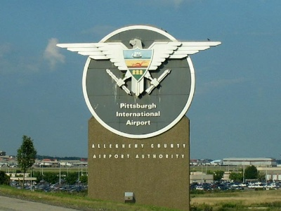
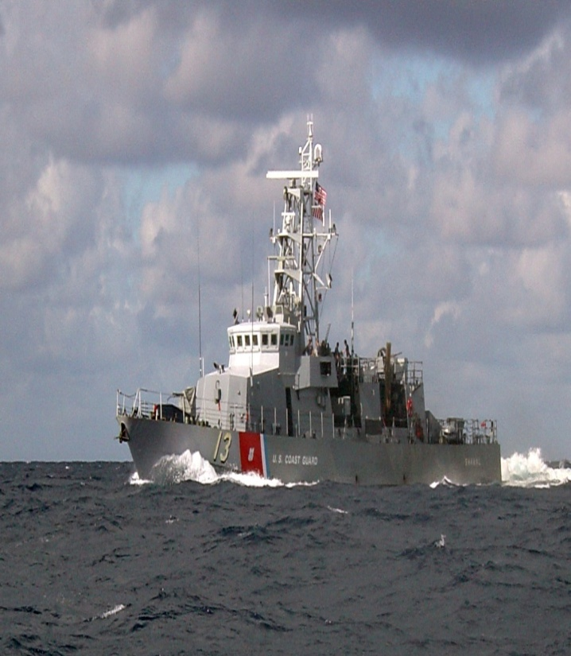


ARMOR: Game Theory Applications
ARMOR - LAX
ARMOR – IRIS: FAMS
ARMOR – PROTECT: USCG
ARMOR – GUARDS: TSA
Notes:
Family of applications of Game Theory to Security:
ARMOR – Assistant for Randomizing Monitoring Over Routes
GUARDS – Game-theoretic Unpredictable and Randomly Deployed Security
IRIS – Intelligent Randomization in International Scheduling
PROTECT – Port Resilience Operational/Tactical Enforcement to Combat Terrorism

Slide 8
ARMOR’s Key Steps
Technical
Pre- and Co-CREATE funding for fundamental R&D through early development
Insightful technology application in critically needed domains
Early adopters and immersion opportunities
Solid technical performance by PIs and Co-Investigators (PDs, RAs)
Business
IP Protection via Invention Disclosures (prior to public disclosure,) patents
Business plan development
Leveraging USC Stevens and local start-up support
Graduating students with entrepreneurial interests
Post-Spinoff nimbleness to pursue developing new markets
Notes:
Even though many industrial companies professed interest in ARMOR, none proceeded to licensing stage

Slide 9
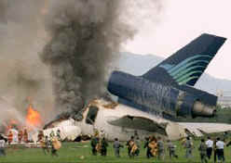
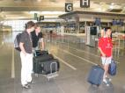
MANPADS: Application of Decision Trees (Nuclear Industry)
Direct Consequences
  Fatalities
  Loss of Airplane
  Injuries
Indirect Consequences
  Aviation System Shutdown
  Reduced Airline Passenger Volume
  Fears and worries
Notes:
Starting with a simple decision tree to characterize the risk, we consider various probabilities of events in a MANPADS attack
The worst case occurs if an attack is attempted, not interdicted, the plane is hit, leading to a fatal crash
Even with interdiction, misses, and safe landing, there will be economic consequences due to fear of flying

Slide 10

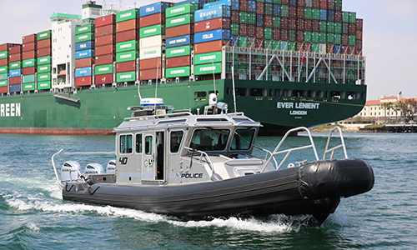
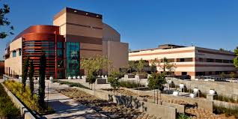
PortSec – Tech Transition Process
Developed & Installed Prototype at POLA Police Headquarters
  Immersion into day-to-day operations (POLA & POLB)
  Multiple evaluation versions of prototype
  Discussions with various venders on funding to “harden” technology into a sustainable product
Outcome
  PortSec technology heavily influenced the development of a POLA Police-funded solution
  Solution is in use today
Notes:
Immersion: To help inform the development of the technology and to develop a relationship with the stakeholders
Multiple versions: Used feedback from personnel to shape technology
Take-away Point: “heavily influenced the development of a POLA Police-funded solution”

