Slide 1
Integrated, Reslient and
Trusted Supply Chains
April 19, 2024

Slide 3
Societal Importance

Slide 4
Importance
Overall Impact on the Economy -- inflation and job creation
Human Livelihood – access to critical items
Vulnerabilities to Disruption
Trust in Suppliers – treatment of workers and environment
Impact of Threats – semiconductors in particular
Protection of Critical Technology

Slide 5
Issues Facing Supply Chains
Armed Conflict
Demand Changes
Domestic Capacity/Investment
Ecological Risks/Environment
Interdependence
Labor Shortages and Standards
Malicious Acts
Market Concentration
Natural Disaster
Pandemic Disruption
Transportation Disruption
Trust in Other Nations

Slide 6
Examples
Semiconductors
Interdependence
Food
Armed Conflict
EV Batteries
Changing Demand, Trust in Nations

Slide 7
CIRT-SC at CREATE
Robust and resilient response to shocks caused by human behavior, conflict, technical failure and natural disaster;
Ethical and trusted sourcing and cooperation, accounting for environmental, social and governance (ESG) criteria, including impacts on the health and livelihood of individuals.

Slide 8
Engineered System

Slide 10
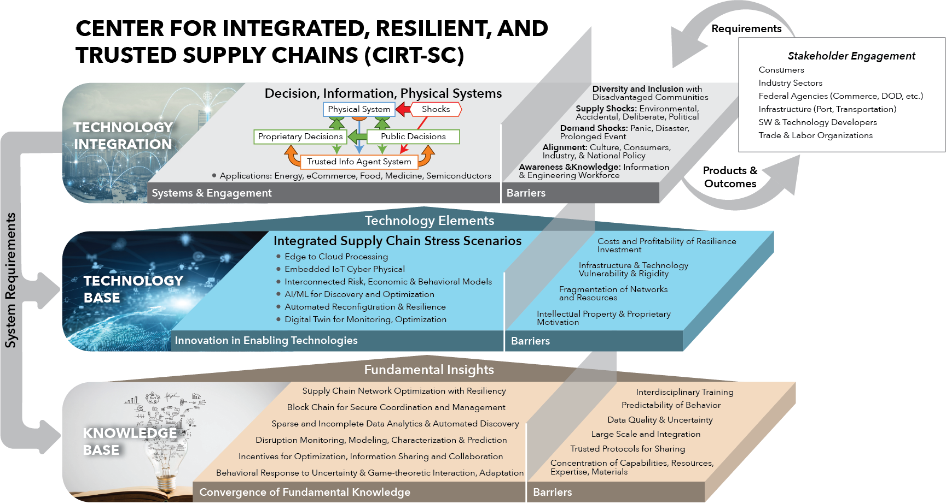

Slide 11
UNIVERSITIES, SCHOOLS, COLLEGES
USC Global Supply Chain Institute, METRANS,
iCorp Hub, Stevens Center
GT Supply Chain & Logistics Institute
IMPACT
Trusted & Resilient Supply Chains
Workforce Development
Diversity & Equity
Knowledge
CIRT-SC TRUSTED KNOWLEDGE EXCHANGE
Data—Software—Pubs—Media--Inventions
Courses—Symposia—Resources--Experiences
STAKEHOLDERS
Transportation,Sectors,Developers, Agencies,Education,Infrastructure,NGO, Labor, Consumers

Slide 12
With University Support
Team of Six Undergraduates and Six PhD Students
Addressing Both Policy and Optimization of Systems
Pursuing Multiple External Funding Possibilities
With DHS Support
Impacts on Economy of Maritime Disruptions, Adam Rose

Slide 13
Emerging Issues
Strategic Deterrence and Interdependent Economies
Extreme Weather Disrupting Supply Chains
Armed Conflict in Disputed Territories
Sanctions as a Deterrence and Economic Impacts
Pandemic Disrupting Demand and Labor Supply
Threats from Rogue Nations
EV Battery Supply Chains and Recycling

Slide 14
CREATE Has Talent and Organization to Lead on Supply Chain Integration, Resilience and Trust

